Slide 1
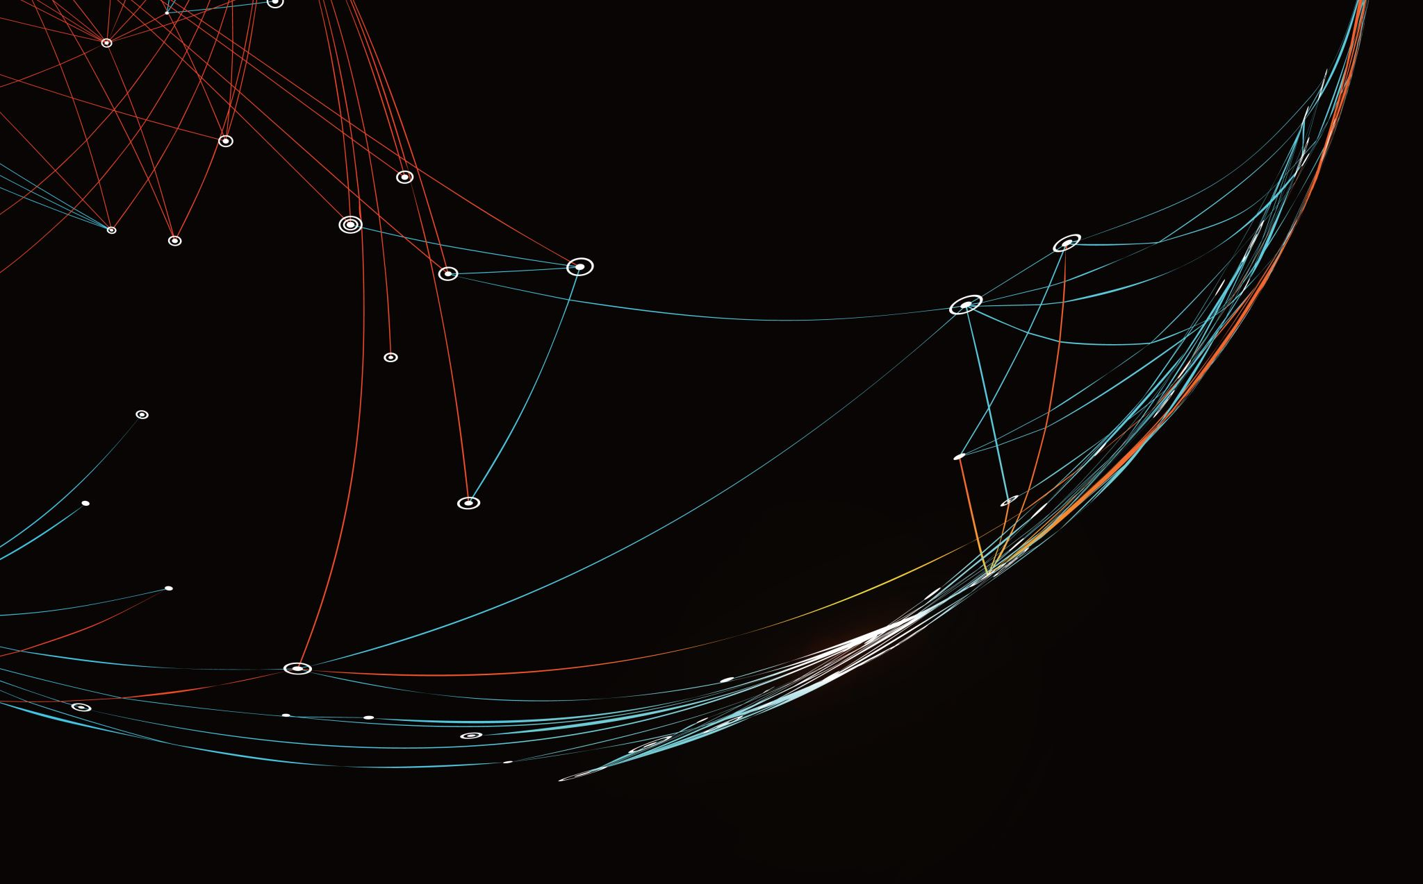
Security Assessment and Risk Management
Week 3 – Impact Assessments

Slide 2
Three elements in every game
Players
Two or more for most games that are interesting
Strategies available to each player
Payoffs
Based on your decision(s) and the decision(s) of other(s)

Slide 3
Payoff Tables, Revisited
Row player always first, Column player second
Each cell is an action or (pure) strategy
Player
 | Left | Right
Left | 1, -1 | -1, 1
Right | -1, 1 | 1, -1
Goalie
Zero-Sum Game

Slide 4
Payoff Tables, Revisited
Two players drive cars towards each other
If one player goes straight, that player wins
If both go straight, they both die
Driver 2
 | Left | Right
Left | 0, 0 | -1, 1
Right | 1, -1 | -5, -5
Driver 1
Not Zero-Sum Game

Slide 5
Nash equilibrium
Any combination of strategies in which each player’s strategy is his or her best choice, given the other players’ choices
Exactly one person deviating from a NE strategy would result in the same payout or lower payout for that person

Slide 6
Finding Nash Equillibrium
Step 1: Pretend you are one of the players
Step 2: Assume that your “opponent” picks a particular action
Step 3: Determine your best strategy (strategies), given your opponent’s action
Step 4: Underline any best choice in the payoff matrix
Step 5: Repeat Steps 2 & 3 for any other opponent strategies
Step 6: Repeat Steps 1 through 4 for the other player
Step 7: Any entry with all numbers underlined is NE

Slide 7
How do we interpret this box?
Person 2
The first number in each box determines the payout for Person 1
The second number determines the payout for Person 2
 | Action C | Action D
Action A | 10, 2 | 8, 3
Action B | 12, 4 | 10, 1
Person 1

Slide 8
How do we interpret this box?
Person 2
Example
If Person 1 chooses Action A and Person 2 chooses Action D, then Person 1 receives a payout of 8 and Person 2 receives a payout of 3
 | Action C | Action D
Action A | 10, 2 | 8, 3
Action B | 12, 4 | 10, 1
Person 1

Slide 9
Steps 1 and 2
Person 2
 | Action C | Action D
Action A | 10, 2 | 8, 3
Action B | 12, 4 | 10, 1
Assume that you are Person 1
Given that Person 2 chooses Action C, what is Person 1’s best choice?
Person 1

Slide 10
Step 3 and 4:
Person 2
 | Action C | Action D
Action A | 10, 2 | 8, 3
Action B | 12, 4 | 10, 1
Underline best payout, given the choice of the other player
Choose Action B, since 12 > 10 ➔ underline 12
Person 1

Slide 11
Step 5
Person 2
 | Action C | Action D
Action A | 10, 2 | 8, 3
Action B | 12, 4 | 10, 1
Now assume that Person 2 chooses Action D
Here, 10 > 8 ➔ Choose and underline 10
Person 1

Slide 12
Step 6
Person 2
 | Action C | Action D
Action A | 10, 2 | 8, 3
Action B | 12, 4 | 10, 1
Now, assume you are Person 2
If Person 1 chooses A
3 > 2 ➔ underline 3
If Person 1 chooses B
4 > 1 ➔ underline 4
Person 1

Slide 13
Step 7
Person 2
 | Action C | Action D
Action A | 10, 2 | 8, 3
Action B | 12, 4 | 10, 1
Which box(es) have underlines under both numbers?
Person 1 chooses B and Person 2 chooses C
This is the only NE
Person 1

Slide 14
Double check our NE
Person 2
 | Action C | Action D
Action A | 10, 2 | 8, 3
Action B | 12, 4 | 10, 1
What if Person 1 deviates from NE?
Could choose A and get 10
Person 1’s payout is lower by deviating 
Person 1

Slide 15
Double check our NE
Person 2
 | Action C | Action D
Action A | 10, 2 | 8, 3
Action B | 12, 4 | 10, 1
What if Person 2 deviates from NE?
Could choose D and get 1
Person 2’s payout is lower by deviating 
Person 1

Slide 16
Dominant strategy
Person 2
 | Action C | Action D
Action A | 10, 2 | 8, 3
Action B | 12, 4 | 10, 1
A strategy is dominant if that choice is definitely made no matter what the other person chooses
Example: Person 1 has a dominant strategy of choosing B
Person 1

Slide 17



Simultaneous/Sequential Decision Making
0, 0 | -1, 1 | 1, -1
1, -1 | 0, 0 | -1, 1
-1, 1 | 1, -1 | 0, 0

Slide 18
New example
Person 2
 | Yes | No
Yes | 20, 20 | 5, 10
No | 10, 5 | 10, 10
Suppose in this example that two people are simultaneously going to decide on this game
Person 1

Slide 19
New example
Person 2
 | Yes | No
Yes | 20, 20 | 5, 10
No | 10, 5 | 10, 10
We will go through the same steps to determine NE
Person 1

Slide 20
Two NE possible
Person 2
 | Yes | No
Yes | 20, 20 | 5, 10
No | 10, 5 | 10, 10
(Yes, Yes) and (No, No) are both NE
Although (Yes, Yes) is the more efficient outcome, we have no way to predict which outcome will actually occur
Person 1

Slide 21
Impact Analysis
Security impact analysis is one of the most critical steps when securing configurations. Its goal is to analyze what will be the security impact of each configuration change on the organization and whether it can expose the organization to attacks. On the other way around, it also indicates how configuration changes benefit the security posture.
Security impact analyses are conducted by teams that deeply understand and know the information system and the potential risks that can be mitigated or exposed by configuration changes.

Slide 22
Impact Analysis
Before the change is deployed –This is done before the change is approved so that any security concern can be addressed before investing energy in changing configurations.
Development and implementation phases –Developers should take security into account when developing the component, considering what configuration changes in the system they may require and how will it influence the entire security posture of the system.

Slide 23
Impact Analysis
After the change is deployed – This is mainly to ensure that your security impact analysis was correct, and you didn’t expose your network to unexpected vulnerabilities. In addition, it is important to analyze the security impact of unscheduled or unauthorized configuration changes that often occur during operations.
After a terrible failure.

Slide 24
Frequency and Probability
Returning back to the quantification of the notion of uncertainty, we first observe that our intuitive usage of the word probability can have two different meanings or forms as related to statements of uncertain outcomes. This is exemplified by two different statements:
1. “If I sail west from Europe, I have a 50 percent chance that I will fall off the edge of the earth.”
2. “If I flip a coin, I have a 50 percent chance that it will land on heads.”
Notes:
Conceptually, these represent two distinct types of probability statements. The first is a statement about
probability as a degree of belief about whether an event will occur and how firmly this belief is held. The
second is a statement about how often a head would be expected to show up in repeated flips of a coin.
The important difference is that the first statement’s validity or truth will be stated. We can clear up the
statement’s veracity for all by sailing across the globe.

Slide 25
Types of Impact
HARM TO OPERATIONS
Inability to perform current missions/business functions.
Harms (e.g., financial costs, sanctions) due to noncompliance.
Direct financial costs.
Relational harms.
Damage to trust relationships.
Damage to image or reputation (and hence future or potential trust relationships).

Slide 26
Types of Impact
HARM TO ASSETS
Damage to or loss of physical facilities.
Damage to or loss of information systems or networks.
Damage to or loss of information technology or equipment.
Damage to or loss of component parts or supplies.
Damage to or of loss of information assets.
Loss of intellectual property.

Slide 27
Types of Impact
HARM TO INDIVIDUALS
Injury or loss of life.
Physical or psychological mistreatment.
Identity theft.
Loss of Personally Identifiable Information.
Damage to image or reputation.

Slide 28
Types of Impact
HARM TO OTHER ORGANIZATIONS
Harms (e.g., financial costs, sanctions) due to noncompliance.
Direct financial costs.
Relational harms.
HARM TO THE NATION
Damage to or incapacitation of a critical infrastructure sector.
Damage to current or future ability to achieve national objectives.

Slide 29
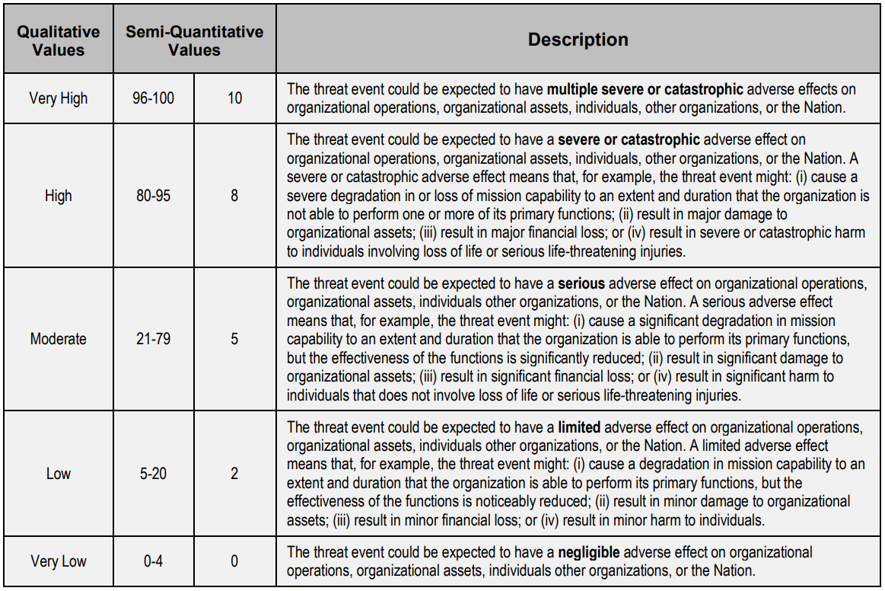

Slide 30
Impact Analysis Steps
Overview of the change – The first step will be to overview the architecture of the change and how it will be implemented.
Identify vulnerabilities in off-the-shelf products- If the change is related to the implementation of a new off-the-shelf product, you should search for known vulnerabilities.
Treat each vulnerability according to its risk –You should assess the risk that each vulnerability you found before taking actions to mitigate it. Identify the likelihood that the vulnerability will be leveraged and the impact of the potential event.
Understand how the change will impact existing security controls – The desired change may involve software installation that requires changing the existing baseline configuration. A good practice will be to compare the change to your hardening policy, to see if any conflicts that may indicate vulnerability.
Develop safeguards and countermeasures – If the desired change exposes the organization to unacceptable risk, you should either choose a different course of action that will allow you to avoid this change or develop a relevant safeguard or practice that will reduce the risk.

Slide 31
Impact Analysis Steps
Overview of the change – when planning to make a change, the first step will be to overview the architecture of the change and how it will be implemented. In case you review a change after it is already made, make sure you get all the documentation and the data by auditing your records, and asking directly the person who made the change. After collecting all the data, investigate the change’s impact on security.
Identify vulnerabilities in off-the-shelf products- if the change is related to the implementation of a new off-the-shelf product, you should search for known vulnerabilities. By searching the National Vulnerability Database, for instance, you can address known vulnerabilities and mitigate them before the product becomes a part of your network. Vulnerability scanners can also come to hand in this situation. If the change involves the implementation of a costume development, you should also analyze it. Make sure to document each discovered vulnerability and what was done for mitigation.
Treat each vulnerability according to its risk – not all vulnerabilities are the same. You should assess the risk that each vulnerability you found before taking actions to mitigate it. Identify the likelihood that the vulnerability will be leveraged and the impact of the potential event. You might decide that the risk is too low and can be accepted without remediation. In other cases, you’ll decide that the risk is too high and decline the change or implement safeguards to reduce it.
Understand how the change will impact existing security controls – for example, the desired change may involve software installation that requires changing the existing baseline configuration. A good practice will be to compare the change to your hardening policy, to see if any conflicts that may indicate vulnerability. In other cases, the change may affect other systems or system components. For example, if you decide to update a database that supports auditing controls, you should take into consideration that auditing activity will be halted while you update the database.
Develop safeguards and countermeasures – if the desired change exposes the organization to unacceptable risk, you should either choose a different course of action that will allow you to avoid this change or develop a relevant safeguard or practice that will reduce the risk.

